Slide 1
Quantitative Analysis in Business Studies
MAN00035C
2026 - Week 8

Slide 2
Week 8: Correlation & Regression
Reading: Oakshott - chapter 10

Slide 3
Last: ANOVA
ANOVA tests if there is a significant difference between the means of three or more groups.
We can either:
- find a difference
- find no difference
If we do, we still don’t know which group(s) was/were different.

Slide 4
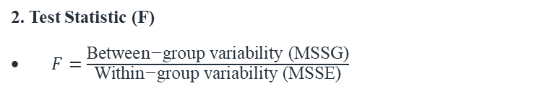
Last topic: ANOVA
1. Hypotheses
Null (H₀): μ₁ = μ₂ = ... = μₖ (all group means are equal)
Alternative (H₁): At least one group mean differs
ANOVA tests if there is a significant difference between the means of three or more groups.
We can either:
- find a difference
- find no difference
If we do, we still don’t know which group(s) was/were different.
2. Test Statistic (F)
$F=\frac{\text{Between}\text{−}\text{group} \text{variability} \text{(}\text{MSSG}\text{)}}{\text{Within}\text{−}\text{group} \text{variability} \text{(}\text{MSSE}\text{)}}$
3. Critical Value (CV)
F-distribution table
Degrees of freedom: df₁ = k – 1 (between groups), k: number of groups df₂ = N – k (within groups), N: total number of datapoints
Significance level (typically α = 0.05)
4. Decision Rule
If F > CV (p.value < 0.05) → Reject H₀
If F < CV (p.value > 0.05) → Do not reject H₀

Slide 5
Outline of the remaining weeks
Week 8 – Correlation & Regression
Week 9 – Time Series Forecasting
Week 10 –Big Data
Week 11 - Revision

Slide 6
Outline of the session
What is Correlation?
How do we measure Correlation?
Does Correlation imply Causation?

Slide 7
Outline of the session
What is Correlation? → Statistical association
How do we measure Correlation? → Correlation coefficient
Does Correlation imply Causation? → NOT Necessarily

Slide 8
Scatter plot
With bivariate data, we can draw a scatter plot. One variable is plotted on the x-axis and the other on the y-axis. (Visualisation)
Normally the x variable (the independent variable) is the one that you believe influences the y variable (the dependent variable). That is y depends on x.
Example: The amount of study time (x) and exam score (y).
In some cases, the distinction between independent and dependent variables is less clear. (e.g., height and weight)

Slide 9
Example
Enquiries from newspaper advertisements
Does the size of the advert depend on the number of enquiries?
OR
Does the number of enquiries depend on the size of the advert?
Notes:
Not necessary to distinguish independent variable and dependent variable in correlation analysis.

Slide 10
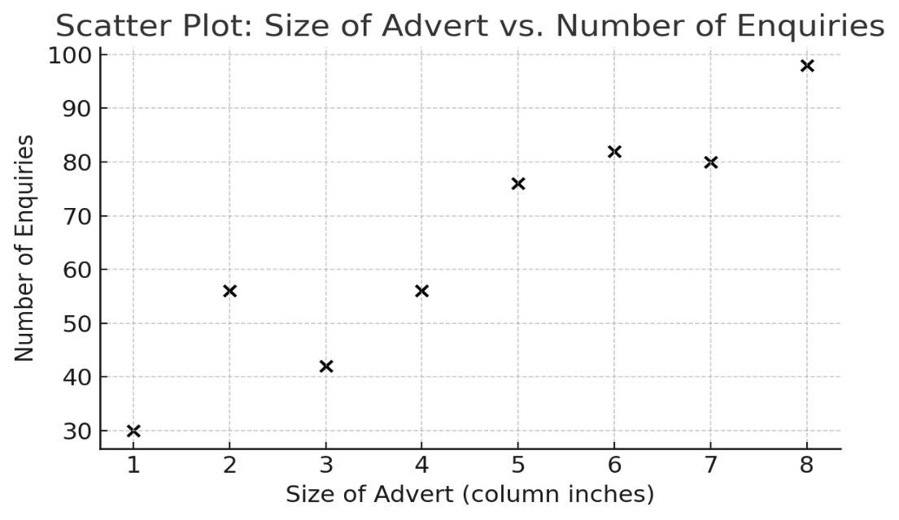
Example
Enquiries from newspaper advertisements
A scatter plot shows the association.

Slide 11
Example
Enquiries from newspaper advertisements
What can you say about the association between the size of the advert and the number of enquiries?

Slide 12
Example
Enquiries from newspaper advertisements
What can you say about the association between the size of the advert and the number of enquiries?
There is a positive association since as the size of the advert increases, so does the number of enquiries
The association looks quite strong (clear and steep upward trend)
Next step: Quantify this association!
Pearson's r, Spearman's rho (ρ) and Kendall's Tau (τ)

Slide 13
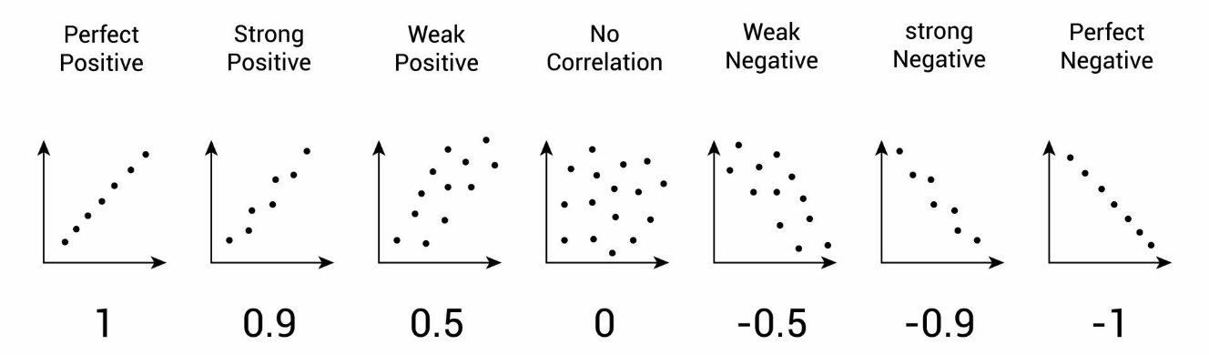
Pearson’s correlation coefficient
Measures the strength of the linear association between two numerical variables.
Usually denoted by the letter r
r lies between –1 (perfect negative association) to +1 (perfect positive association)

Slide 14
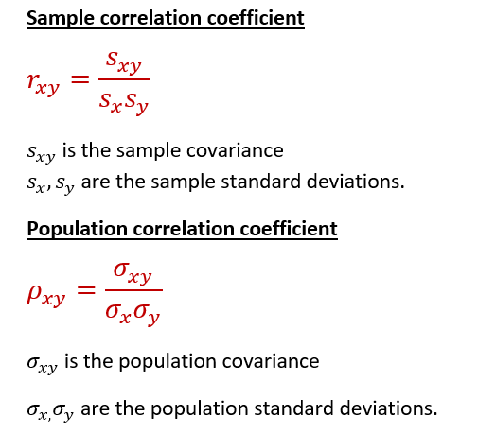
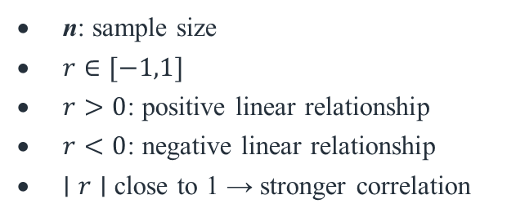
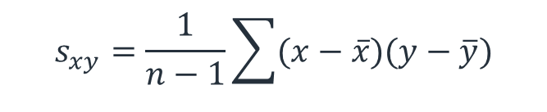
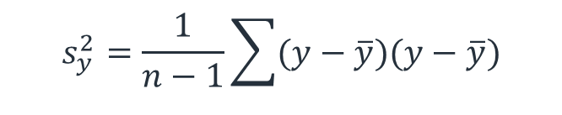

Pearson’s correlation coefficient
$$s_{x}^{2}=\frac{1}{n−1}\sum{(x−\overline{x})(x−\overline{x})}$$
$$s_{y}^{2}=\frac{1}{n−1}\sum{(y−\overline{y})(y−\overline{y})}$$
$$s_{xy}=\frac{1}{n−1}\sum{(x−\overline{x})(y−\overline{y})}$$
n: sample size
$r∈[−1,1]$
$r>0$: positive linear relationship
$r<0$: negative linear relationship
$∣r∣$ close to 1 → stronger correlation

Slide 15

Pearson’s correlation coefficient
We use the following formula to calculate the correlation coefficient (which gives the same result).
$$r=\frac{n\sum{xy}−\sum{x}\sum{y}}{\sqrt{\left[n\sum{x^{2}}−{\left(\sum{x}\right)}^{2}\right]\left[n\sum{y^{2}}−{\left(\sum{y}\right)}^{2}\right]}}$$

Slide 16
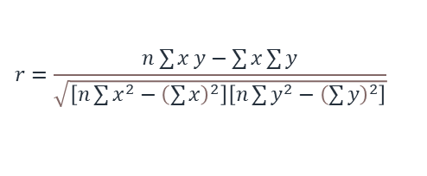
Pearson’s correlation coefficient
$$r=\frac{n\sum{x}y−\sum{x}\sum{y}}{\sqrt{\left[n\sum{x^{2}}−{\left(\sum{x}\right)}^{2}\right]\left[n\sum{y^{2}}−{\left(\sum{y}\right)}^{2}\right]}}$$
Newspaper Example
x: advert size and y: number of enquiries
 | x | y
 | 4 | 56
 | 5 | 76
 | 7 | 80
 | 2 | 56
 | 6 | 82
 | 3 | 42
 | 1 | 30
 | 8 | 98

Slide 17
Pearson’s correlation coefficient
$$r=\frac{n\sum{x}y−\sum{x}\sum{y}}{\sqrt{\left[n\sum{x^{2}}−{\left(\sum{x}\right)}^{2}\right]\left[n\sum{y^{2}}−{\left(\sum{y}\right)}^{2}\right]}}$$
Newspaper Example
x: advert size and y: number of enquiries
 | x | y | xy
 | 4 | 56 | 224
 | 5 | 76 | 380
 | 7 | 80 | 560
 | 2 | 56 | 112
 | 6 | 82 | 492
 | 3 | 42 | 126
 | 1 | 30 | 30
 | 8 | 98 | 784

Slide 18
Pearson’s correlation coefficient
$$r=\frac{n\sum{x}y−\sum{x}\sum{y}}{\sqrt{\left[n\sum{x^{2}}−{\left(\sum{x}\right)}^{2}\right]\left[n\sum{y^{2}}−{\left(\sum{y}\right)}^{2}\right]}}$$
Newspaper Example
x: advert size and y: number of enquiries
 | x | y | xy | x² | y²
 | 4 | 56 | 224 | 16 | 3136
 | 5 | 76 | 380 | 25 | 5776
 | 7 | 80 | 560 | 49 | 6400
 | 2 | 56 | 112 | 4 | 3136
 | 6 | 82 | 492 | 36 | 6724
 | 3 | 42 | 126 | 9 | 1764
 | 1 | 30 | 30 | 1 | 900
 | 8 | 98 | 784 | 64 | 9604

Slide 19
Pearson’s correlation coefficient
$$r=\frac{n\sum{x}y−\sum{x}\sum{y}}{\sqrt{\left[n\sum{x^{2}}−{\left(\sum{x}\right)}^{2}\right]\left[n\sum{y^{2}}−{\left(\sum{y}\right)}^{2}\right]}}$$
Newspaper Example
x: advert size and y: number of enquiries
 | x | y | xy | x² | y²
 | 4 | 56 | 224 | 16 | 3136
 | 5 | 76 | 380 | 25 | 5776
 | 7 | 80 | 560 | 49 | 6400
 | 2 | 56 | 112 | 4 | 3136
 | 6 | 82 | 492 | 36 | 6724
 | 3 | 42 | 126 | 9 | 1764
 | 1 | 30 | 30 | 1 | 900
 | 8 | 98 | 784 | 64 | 9604
Sum | 36 | 520 | 2708 | 204 | 37440

Slide 20


Pearson’s correlation coefficient
$$r=\frac{n\sum{x}y−\sum{x}\sum{y}}{\sqrt{\left[n\sum{x^{2}}−{\left(\sum{x}\right)}^{2}\right]\left[n\sum{y^{2}}−{\left(\sum{y}\right)}^{2}\right]}}$$
Newspaper Example
x: advert size and y: number of enquiries
 | x | y | xy | x² | y²
 | 4 | 56 | 224 | 16 | 3136
 | 5 | 76 | 380 | 25 | 5776
 | 7 | 80 | 560 | 49 | 6400
 | 2 | 56 | 112 | 4 | 3136
 | 6 | 82 | 492 | 36 | 6724
 | 3 | 42 | 126 | 9 | 1764
 | 1 | 30 | 30 | 1 | 900
 | 8 | 98 | 784 | 64 | 9604
Sum | 36 | 520 | 2708 | 204 | 37440
$$r=\frac{8∗2708−36∗520}{\sqrt{\left[8∗204−{\left(36\right)}^{2}\right]\left[8∗37440−{\left(520\right)}^{2}\right]}}$$
$$r=\frac{2944}{\sqrt{336∗29120}}$$
$$r=0.9412$$

Slide 21
Pearson’s correlation coefficient
$$r=\frac{n\sum{x}y−\sum{x}\sum{y}}{\sqrt{\left[n\sum{x^{2}}−{\left(\sum{x}\right)}^{2}\right]\left[n\sum{y^{2}}−{\left(\sum{y}\right)}^{2}\right]}}$$
Newspaper Example
x: advert size and y: number of enquiries
 | x | y | xy | x² | y²
 | 4 | 56 | 224 | 16 | 3136
 | 5 | 76 | 380 | 25 | 5776
 | 7 | 80 | 560 | 49 | 6400
 | 2 | 56 | 112 | 4 | 3136
 | 6 | 82 | 492 | 36 | 6724
 | 3 | 42 | 126 | 9 | 1764
 | 1 | 30 | 30 | 1 | 900
 | 8 | 98 | 784 | 64 | 9604
Sum | 36 | 520 | 2708 | 204 | 37440
$$r=\frac{8∗2708−36∗520}{\sqrt{\left[8∗204−{\left(36\right)}^{2}\right]\left[8∗37440−{\left(520\right)}^{2}\right]}}$$
$$r=\frac{2944}{\sqrt{336∗29120}}$$
$$r=0.9412$$
the correlation is quite strong (close to 1) and positive.

Slide 22
Pearson’s correlation coefficient
$$r=\frac{n\sum{x}y−\sum{x}\sum{y}}{\sqrt{\left[n\sum{x^{2}}−{\left(\sum{x}\right)}^{2}\right]\left[n\sum{y^{2}}−{\left(\sum{y}\right)}^{2}\right]}}$$
Newspaper Example
x: advert size and y: number of enquiries
 | x | y | xy | x² | y²
 | 4 | 56 | 224 | 16 | 3136
 | 5 | 76 | 380 | 25 | 5776
 | 7 | 80 | 560 | 49 | 6400
 | 2 | 56 | 112 | 4 | 3136
 | 6 | 82 | 492 | 36 | 6724
 | 3 | 42 | 126 | 9 | 1764
 | 1 | 30 | 30 | 1 | 900
 | 8 | 98 | 784 | 64 | 9604
Sum | 36 | 520 | 2708 | 204 | 37440
$$r=\frac{8∗2708−36∗520}{\sqrt{\left[8∗204−{\left(36\right)}^{2}\right]\left[8∗37440−{\left(520\right)}^{2}\right]}}$$
$$r=\frac{2944}{\sqrt{336∗29120}}$$
$$r=0.9412$$
the correlation is quite strong (close to 1) and positive.
…as expected from the scatter plot!

Slide 23
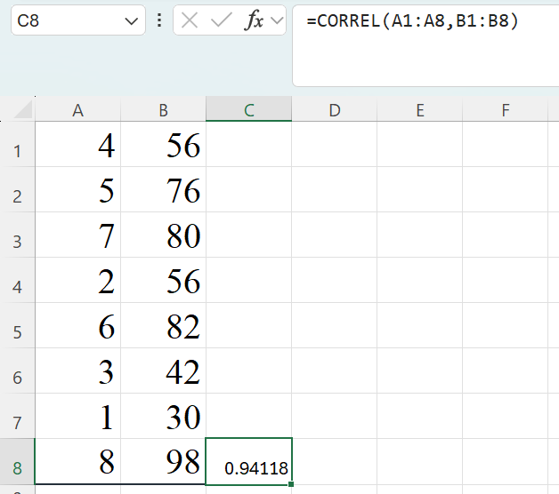
CORREL function in EXCEL
The CORREL function returns the correlation coefficient of two cell ranges.
Use the correlation coefficient to determine the statistical relationship between two variables.
Syntax
=CORREL(array1, array2)
>> array1 - A range of cell values
>> array2 - A second range of cell values.

Slide 24
Testing for statistically significant correlation (1)
The value of r doesn’t necessarily tell us if the correlation is significantly different from zero
→We can test it!
Let’s go back to the example of adverts and enquiries…

Slide 25
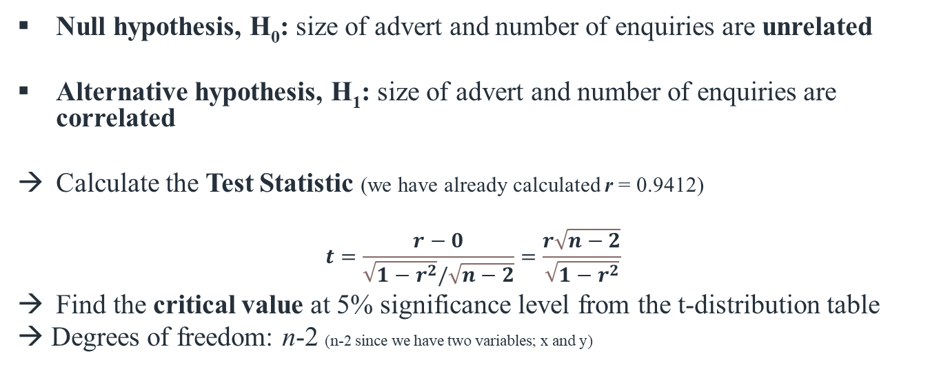
Testing for statistically significant correlation (2)
Null hypothesis, H₀: size of advert and number of enquiries are unrelated
Alternative hypothesis, H₁: size of advert and number of enquiries are correlated
Calculate the Test Statistic (we have already calculated r = 0.9412)
$$t=\frac{r−0}{\sqrt{1−r^{2}}/\sqrt{n−2}}=\frac{r\sqrt{n−2}}{\sqrt{1−r^{2}}}$$
Find the critical value at 5% significance level from the t-distribution table
→ Degrees of freedom: n-2 (n-2 since we have two variables; x and y)

Slide 26

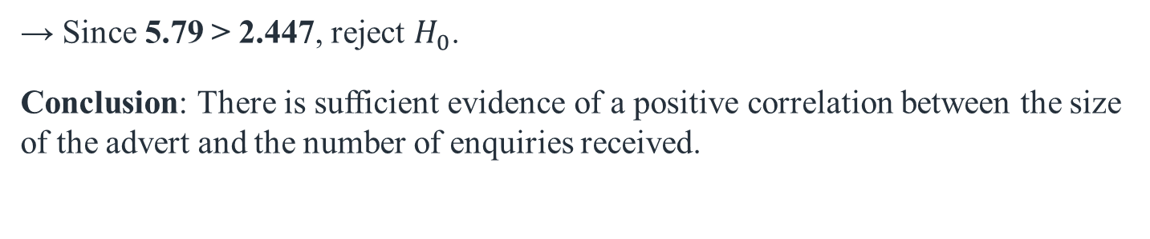
Testing for statistically significant correlation (3)
Null hypothesis, H₀: size of advert and number of enquiries are unrelated
Alternative hypothesis, H₁: size of advert and number of enquiries are correlated
$$t=\frac{r\sqrt{n−2}}{\sqrt{1−r^{2}}}=\frac{0.9412×\sqrt{6}}{\sqrt{1−{0.9412}^{2}}}≈5.79$$
Critical Value (two-tailed, $α=0.05$, $df=6$) = ±2.447
→ Since 5.79 > 2.447, reject $H_{0}$.
Conclusion: There is sufficient evidence of a positive correlation between the size of the advert and the number of enquiries received.

Slide 27
More scatter plots
Non-linear
Random
Straight line, but x tells us nothing about y

Slide 28
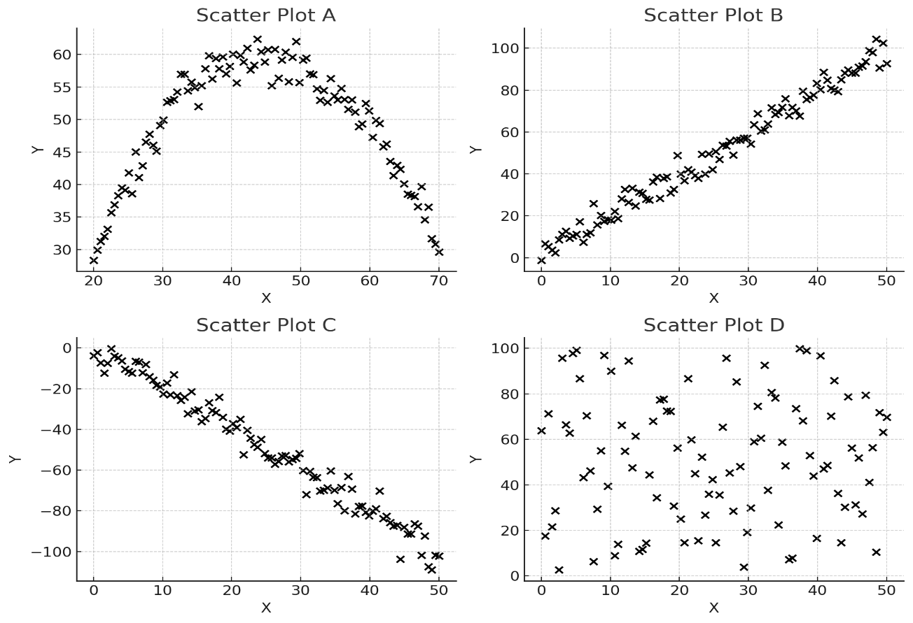
More scatter plots

Slide 29
Guess the correlation
Use menti.com: 3330 8654
The Correlation Game
An upward trend indicates a positive correlation.
A downward trend indicates a negative correlation.
The closer the points lie to a straight line, the stronger the correlation.
If the points follow a horizontal line, this indicates no correlation.

Slide 30
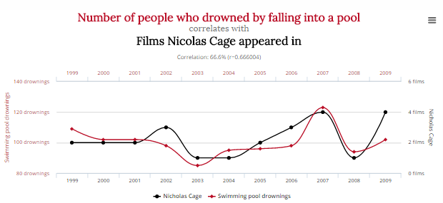

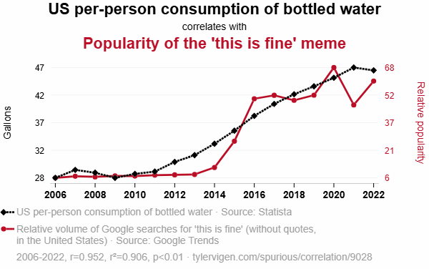
Corelation vs Causation
Notes:
The time series plot of the two variables show they move up and down simutaniously and thus they are correlated if we plot each pair…

Slide 31

Corelation vs Causation
Notes:
Two things happen together. You cannot conclude causation from correlation.

Slide 32
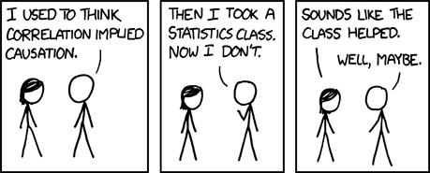
Corelation vs Causation
If two variables are correlated, it means nothing more or less than that they are related in some way.

Slide 33
Corelation vs Causation
It DOES NOT tell you anything about
how they’re linked,
whether one changing causes the other to change, vice versa, or
whether a hidden third factor causes both of them to change in some way.
If two variables are correlated, it means nothing more or less than that they are related in some way.

Slide 34
Correlation DOES NOT IMPLY Causation
Sales of ice cream and the number of people drowning are correlated.
One may not cause the other.

Slide 35
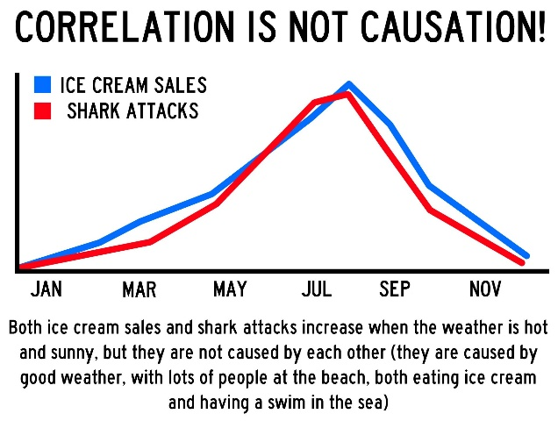
Correlation DOES NOT IMPLY Causation
They are both related to hot sunny days and people going to the beach.
However, the correlation does indicate that further investigation could be done.
Sales of ice cream and the number of people drowning are correlated.
One may not cause the other.

Slide 36
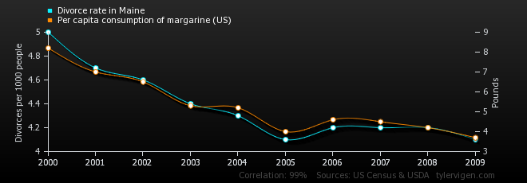
Correlation DOES NOT IMPLY Causation
www.tylervigen.com

Slide 37
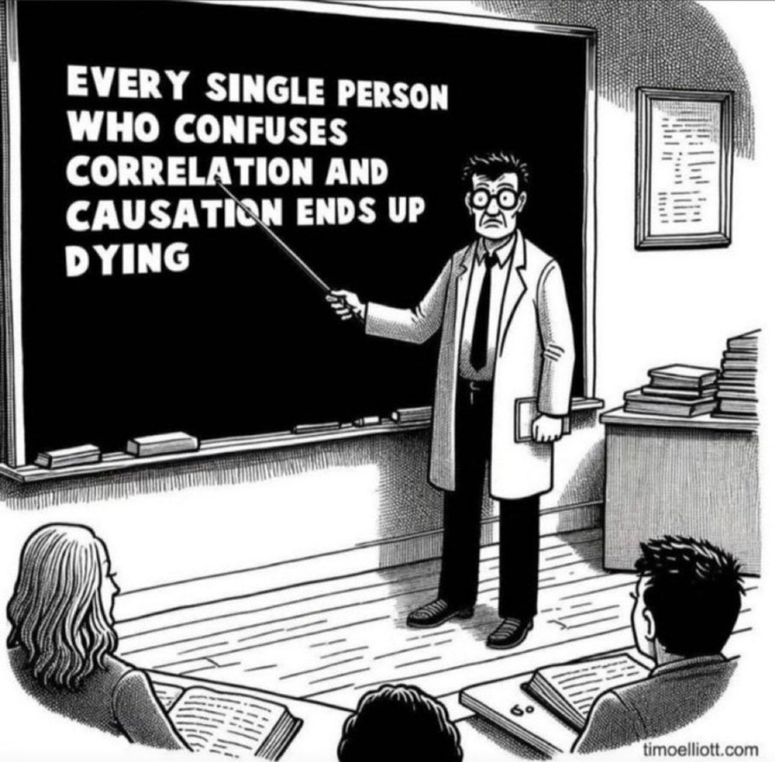
Correlation DOES NOT IMPLY Causation
Notes:
Everyone who drinks water also eventually dies. Does water cause death? Of course not. That’s the same trick this slide is using.

Slide 38
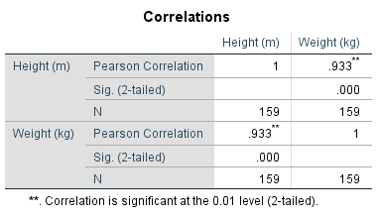
SPSS: Correlation & Covariance
Height (m) | Weight (kg)
1.65 | 52
1.91 | 88
1.85 | 74
1.79 | 76
1.71 | 65
1.70 | 58
… | …
r = 0.933 → a strong positive correlation
p.value = 0.000 < 0.05 → Reject H₀, hence this correlation is statistically different from zero.

Slide 39
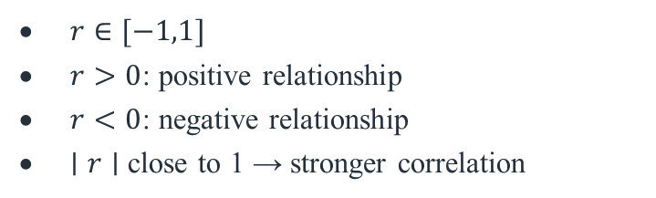
Conclusions
The correlation between two variables can be either positive or negative, depending on whether one variable increases or decreases with an increase in the other variable.
The correlation does not imply causation

Slide 40
Next Topic
- Regression

Slide 41
Last topic: Correlation
The correlation between two variables can be either positive or negative, depending on whether one variable increases or decreases with an increase in the other variable.
Pearson’s correlation coefficient measures the strength of the linear association between two numerical variables. It is usually denoted by the letter r
r lies between –1 (perfect negative association) to +1 (perfect positive association)
The correlation does not imply causation

Slide 42
Outline of the session
What is Regression?
How to interpret Regression output?

Slide 43
Outline of the session
What is Regression? → Overview of the Simple Linear Regression.
Correlation shows the association between x and y. (x ←→ y)
Regression shows how x predicts y. (x → y)
How to interpret Regression output? → R², statistical significance of the regression (F-test), coefficients’ sign and magnitude, coefficients’ statistical significance
Does Regression imply Causation? → NOT Necessarily

Slide 44

Example
Enquiries from newspaper advertisements
With bivariate data, we have a dependent and an independent variable → the dependent variable depends on the independent variable
Does the size of the advert depend on the number of enquiries?
OR
Does the number of enquiries depend on the size of the advert?

Slide 45
Example
Enquiries from newspaper advertisements
Does the number of enquiries depend on the size of the advert?
We’re looking to understand whether larger ads (independent variable) tend to attract more enquiries (dependent variable).
Is it possible to quantify the linear relationship between the two variables?
That is, if we know the size of the advert, can we predict the number of enquiries?
We could try drawing a straight line by eye through the scatter plot but the best method is to use the least squares method

Slide 46
The least squares regression line
The ideas is to make vertical errors (residuals) as small as possible so the predicted values from the line are close to the actual data values.
Positive error
Y
e₅
e₆
e₂
e₄= 0
e₃
e₁
Negative error
X
Notes:
Why square the gaps? To avoid negatives cancelling out positives.

Slide 47
The least squares regression line
Positive error
Y
e₅
e₆
e₂
e₄= 0
y = a + bx
We need to find the values of a and b that minimize the sum of squared errors.
*Why squared?
e₃
e₁
Negative error
X
Notes:
Why square the gaps? To avoid negatives cancelling out positives.

Slide 48
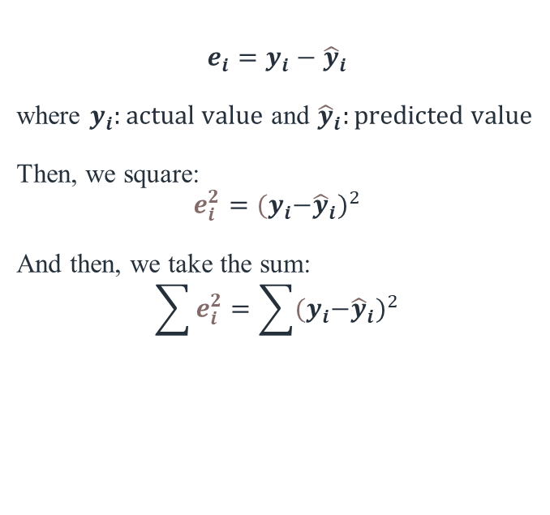
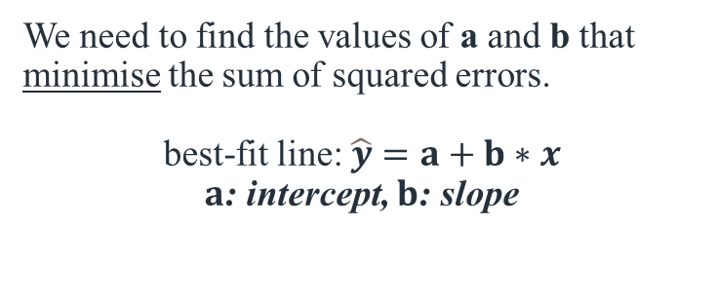
The least squares regression line
$$e_{i}=y_{i}−{\hat{y}}_{i}$$
where $y_{i}:actual value$ and ${\hat{y}}_{i}:predicted value$
Then, we square:
$$e_{i}^{2}={{(y}_{i}−{\hat{y}}_{i})}^{2}$$
And then, we take the sum:
$$\sum{e_{i}^{2}=\sum{{{(y}_{i}−{\hat{y}}_{i})}^{2}}}$$
Positive error
Y
e₅
e₆
e₂
e₄= 0
e₃
e₁
Negative error
We need to find the values of a and b that minimise the sum of squared errors.
best-fit line: $\hat{y}=a+b∗x$
$a$: intercept, $b$: slope
X

Slide 49
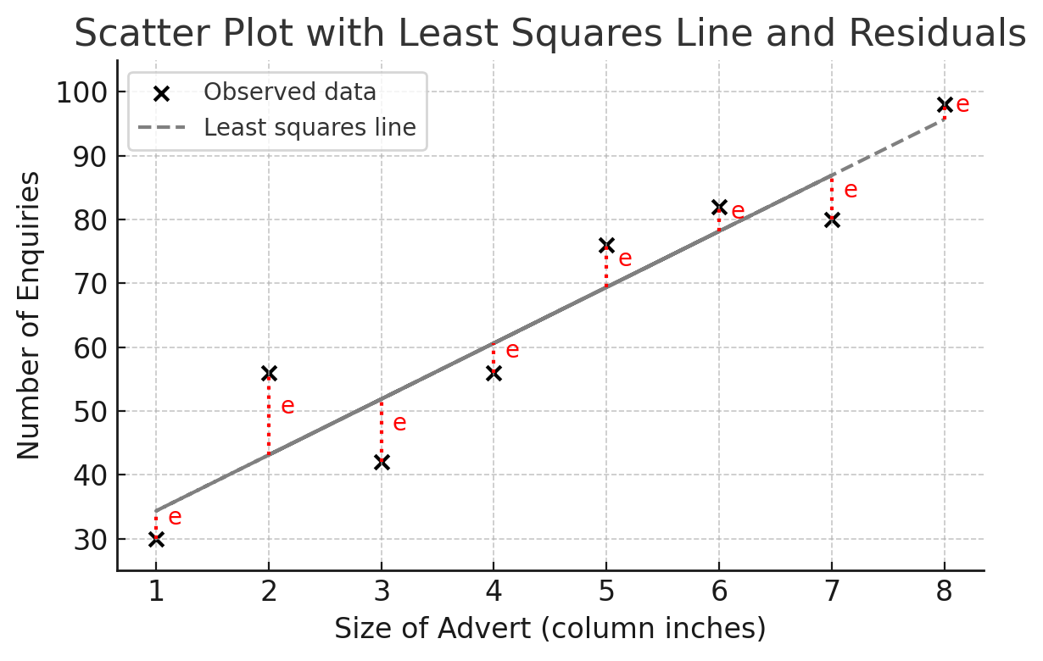
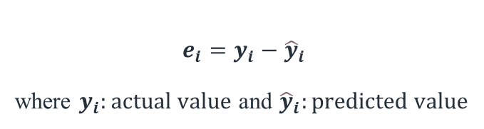
The least squares (summary)
The Least Squares Method is a way to draw the best-fitting straight line through a scatter plot of data.
For each point, there's a vertical gap between the actual data point and where the line predicts.
These gaps are called residuals (or errors).
The line is chosen so that the squares of these gaps are as small as possible overall.
$$e_{i}=y_{i}−{\hat{y}}_{i}$$
where $y_{i}:actual value$ and ${\hat{y}}_{i}:predicted value$

Slide 50


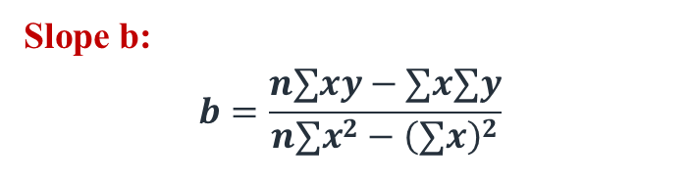
Regression coefficients
$$e_{i}=y_{i}−{\hat{y}}_{i}$$
where $y_{i}:actual value$ and ${\hat{y}}_{i}:predicted value$
Then, we square:
$$e_{i}^{2}={{(y}_{i}−{\hat{y}}_{i})}^{2}$$
And then, we take the sum:
$$\sum{e_{i}^{2}=\sum{{{(y}_{i}−{\hat{y}}_{i})}^{2}}}$$
Slope b:
$$b=\frac{n∑xy−∑x∑y}{n∑x^{2}−{\left(∑x\right)}^{2}}$$
Intercept a:
$$a=\frac{∑y}{n}−b∗\frac{∑x}{n}$$
We need to find the values of a and b that minimise the sum of squared errors.
best-fit line: $\hat{y}=a+b∗x$
$a$: intercept, $b$: slope

Slide 51


Example
Newspaper Example
x: advert size and y: number of enquiries
Slope b:
$$b=\frac{n∑xy−∑x∑y}{n∑x^{2}−{\left(∑x\right)}^{2}}$$
 | x | y | xy | x² | y²
 | 4 | 56 | 224 | 16 | 3136
 | 5 | 76 | 380 | 25 | 5776
 | 7 | 80 | 560 | 49 | 6400
 | 2 | 56 | 112 | 4 | 3136
 | 6 | 82 | 492 | 36 | 6724
 | 3 | 42 | 126 | 9 | 1764
 | 1 | 30 | 30 | 1 | 900
 | 8 | 98 | 784 | 64 | 9604
Sum | 36 | 520 | 2708 | 204 | 37440
= 8.762
Intercept a:
$$a=\frac{∑y}{n}−b∗\frac{∑x}{n}$$
=25.57

Slide 52
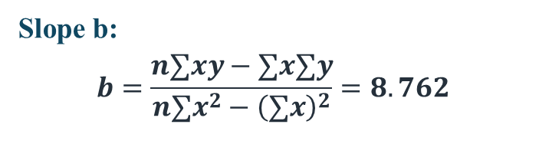

Example and interpretation
Enquiries from newspaper advertisements
Slope b:
$$b=\frac{n∑xy−∑x∑y}{n∑x^{2}−{\left(∑x\right)}^{2}}=8.762$$
Intercept a:
$$a=\frac{∑y}{n}−b∗\frac{∑x}{n}=25.57$$
Hence, we have that:
Number of Enquiries = 25.57 + 8.762*Size of Advert
The 25.6 can be thought of as the fixed element, i.e. you will get this number of enquiries, no matter the size of the advert.
The 8.762 is the increase in the number of adverts for every extra column inch.

Slide 53
Example and interpretation
Enquiries from newspaper advertisements
Slope b:
$$b=\frac{n∑xy−∑x∑y}{n∑x^{2}−{\left(∑x\right)}^{2}}=8.762$$
Intercept a:
$$a=\frac{∑y}{n}−b∗\frac{∑x}{n}=25.57$$
Hence, we have that:
Number of Enquiries = 25.57 + 8.762*Size of Advert
Prediction: What is the predicted number of enquiries if the advert has a size of 2 inches?
Number of Enquiries = 25.57 + 8.762*2 = 43.1

Slide 54
Coefficient of determination (R²)
R² is a measure of the goodness of fit of a model.
This statistic tells us what proportion of the variation in the dependent variable is explained by the variation in the independent variable.
→ For simple linear regression, R²=r² , i.e., squaring the correlation coefficient.
R² =r² =0.9412²
= 0.886 or 88.6%
So, 88.6% of the variation in the number of enquiries is explained by the size of the advert (and 11.4% is explained by other factors).

Slide 55
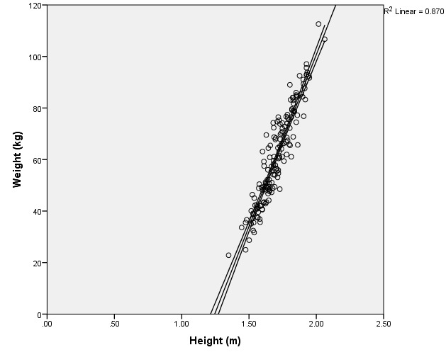
Interpolation and Extrapolation
Interpolation is applying the regression line within the range of the observed data. The line is based on real patterns seen in the data, so estimates between known points are likely reliable. It’s descriptive.
Extrapolation uses the regression line to estimate values outside the range of observed data. We assume the relationship continues the same way beyond the data — which may not be. It’s predictive.

Slide 56
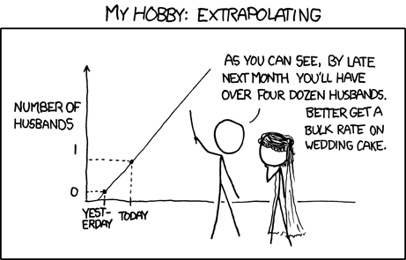

Slide 57
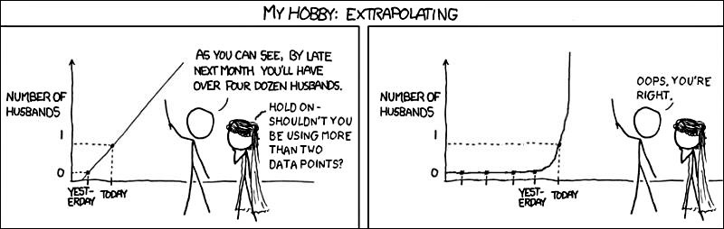
Risk of extrapolation is not due to lack of data.

Slide 58
Conclusions
The least squares method fits the best line by minimising the sum of squared residuals, ensuring predictions are as close as possible to the actual data.
The slope and intercept in the regression equation quantify the direction and strength of the relationship between the independent and dependent variable.
Goodness-of-fit and significance are evaluated through R² (how much variation is explained)
Tomorrow: the ANOVA F-test and more

Slide 59
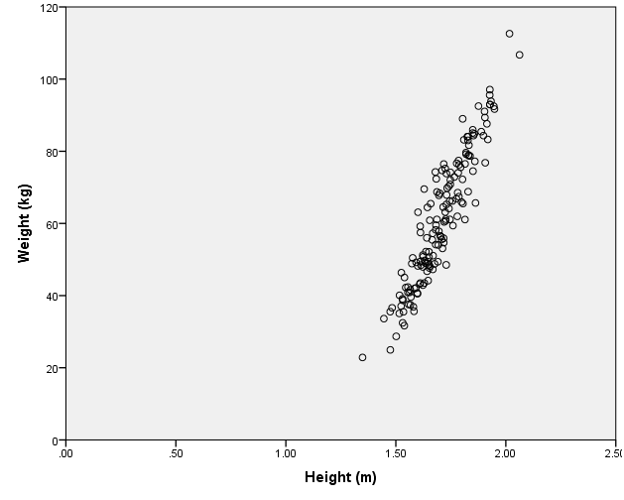
SPSS regression output
We look at Weight (y) and Height (x), both are continuous variables.
We run the regression:
Weight = a + b*Height
and we take the SPSS output.

Slide 60
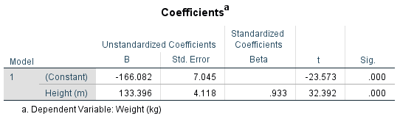
equation: W = 133*H-166
Standard Errors
Test
Statistics
Slope of standardised data
p-values

Slide 61
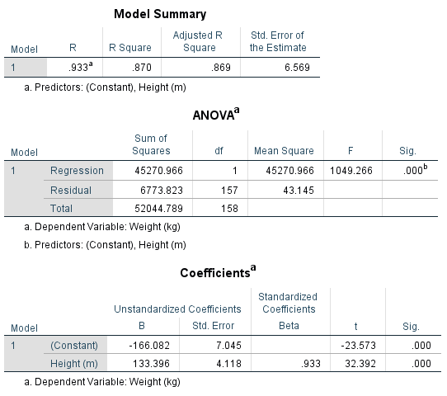

SPSS regression output
1. Regression Line (from Coefficients table)
The estimated regression equation is:
$$\hat{\text{Weight} \text{(}\text{kg}\text{)}}=−166.08+133.40⋅\text{Height} \text{(}\text{m}\text{)}$$
Interpretation:
Intercept: At height = 0, predicted weight is –166.08 kg (not meaningful here, but part of the equation).
Slope: Each additional metre in height increases weight by 133.40 kg, on average.
2. Correlation Coefficient (R) and Coefficient of Determination (R²)
R = 0.933 → Strong positive linear correlation between height and weight.
R² = 0.870 → 87% of the variation in weight is explained by height. Very high explanatory power.

Slide 62
SPSS regression output
3. ANOVA Table: Testing Overall Significance of the Regression
F-statistic = 1049.27, p-value = 0.000 → The regression model is statistically significant at any conventional level (e.g., 1%, 5%). → Interpretation: Height significantly predicts weight.
Hint: In regression, ANOVA tests whether the regression model explains a significant amount of variation in the dependent variable (Y) — in this case, Weight.
4. Coefficients Table: Sign, Magnitude, and Significance
Both the intercept and slope have p-values = 0.000, meaning both are statistically significant.
Slope (133.396): Large magnitude; the association of height with weight is substantial and positive.

Slide 63
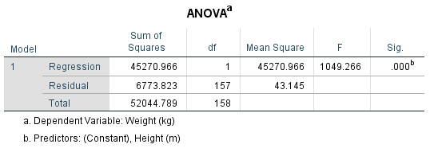
ANOVA revisited

Slide 64
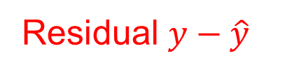
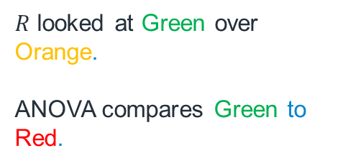

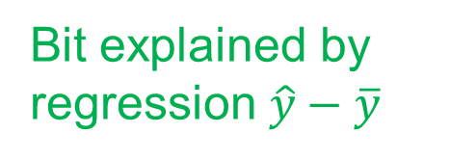


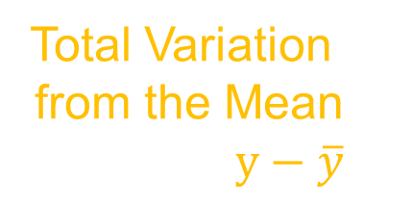
ANOVA applied to Regression
Line of best fit $\hat{y}$
Data point $y$
$R$ looked at Green over Orange.
ANOVA compares Green to Red.
Residual $y−\hat{y}$
Total Variation from the Mean $y−\overline{y}$
Bit explained by regression $\hat{y}−\overline{y}$
Mean of data $\overline{y}$
The null hypothesis is equivalent to assuming that 𝑦 ̂ and 𝑦 ̅ are the same.

Slide 65
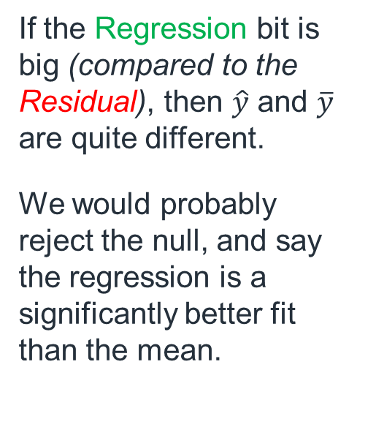
ANOVA applied to Regression
Line of best fit $\hat{y}$
If the Regression bit is big (compared to the Residual), then $\hat{y}$ and $\overline{y}$ are quite different.
We would probably reject the null, and say the regression is a significantly better fit than the mean.
Data point $y$
Residual $y−\hat{y}$
Total Variation from the Mean $y−\overline{y}$
Bit explained by regression $\hat{y}−\overline{y}$
Mean of data $\overline{y}$

Slide 66
ANOVA revisited
Test Statistic (meaningless without CV)
Predictors - 1
p-value
Datapoints - 1
Notes:
ANOVA and the t-test for the slope (the coefficient on the explanatory variable) measure the same thing, in much the same way.
So the p-value for ANOVA and the p-value for that t-test are the same.

Slide 67
Further discussion
Some important assumptions:
The linear relationship holds between x and y
Data should be representative, and the sample size should be sufficient
Small sample t-test relies on normal assumption.
Z-test relies on large sample size.
The errors are independent to each other and have a constant variance. (Residual plots can be used to check this)
So far, we have only looked at one independent variable but it is possible to have multiple explanatory variables.

Slide 68


Simpson’s paradox
Imagine a zoo. There are 2 species of animals: rhinos and giraffes.
The staff measure the heights and weights of all the animals.
When they regress all the animals together, the taller the animal, the less it should weigh (negative relationship)
But when they regress each species separately, within species, taller animals are heavier (positive relationship)
Weight
Height
Notes:
Simpson's Paradox is a statistical phenomenon where a trend observed in multiple separate groups of data disappears or reverses when the groups are combined (aggregated). This counterintuitive reversal happens because the aggregated data ignores important lurking variables or hidden, unequal weightings between groups, potentially leading to incorrect conclusions.

Slide 69


Simpson’s Paradox
Positive correlation
for Rhinos
Weight
Positive correlation
for Giraffes
Height

Slide 70


Simpson’s Paradox
Negative correlation
overall
Weight
Height

Slide 71
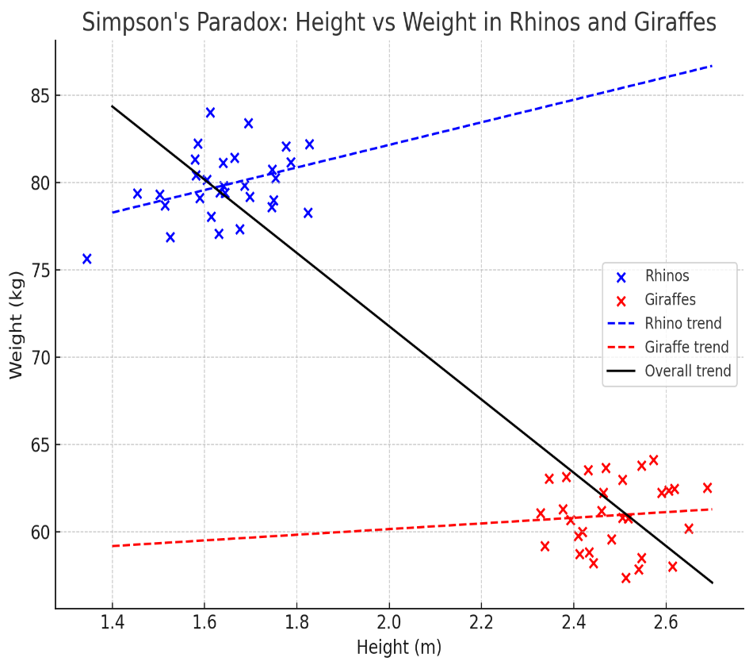
Simpson’s Paradox
Imagine a zoo. There are 2 species of animals: rhinos and giraffes.
The staff measure the heights and weights of all the animals.
When they regress all the animals together, the taller the animal, the less it should weigh (negative relationship)
But when they regress each species separately, within species, taller animals are heavier (positive relationship)

Slide 72
Conclusions
The least squares method fits the best line by minimising the sum of squared residuals, ensuring predictions are as close as possible to the actual data.
The slope and intercept in the regression equation quantify the direction and strength of the relationship between the independent and dependent variable.
Goodness-of-fit and significance are evaluated through R² (how much variation is explained) and the ANOVA F-test (whether the model is statistically meaningful).

Slide 73
Next Week
Time Series Forecasting
→ We will build on today’s lecture on regression and forecasting

